Slide 1
My Journey in Compiler Design
By Toby Duncan

Slide 2
A quick Quote...
“Toby is doing a senior project in compiler design, feel bad for Toby” - Alan COSC 251

Slide 3
Should you have felt bad for me?
The answer: Maybe
There are two things I use to measure this:
Was it fun?
Was it rewarding?
Will come back to the topic at the end of the presentation

Slide 4
Outline of Presentation
What actually is a compiler
Stages of a compiler
Lexical Analysis
Syntactic Analysis
Semantic Analysis
Inter Code Gen
Code Gen
Reflection
What went well
Where could I have improved
Where I want to take this in the future
Wrap up and Questions

Slide 5
What is actual a compiler?
“A computer program that translates an entire set of instructions written in a higher-level symbolic language (such as C) into machine language before the instructions can be executed” - Merriam Webster
In my case it turned a programming language into target assembly
This is not an interpreter!
An interpreter takes a programming language and translates it into another programming language
So what did I end of translating?
Notes:
Let’s start with the basics…what actual is a compiler

Slide 6
InSpace Programming Language
InSpace was an un-implemented programming language on the website esolang.
Webpage for it: https://esolangs.org/wiki/InSpace by esolang user Zayne
Best way to think about it is lots of pre-defined functions that are then used to create programs

Slide 7
Lexical Analysis Overview
First stage of a compiler
Turns the source code into a bunch of tokens or lexemes to be used at later stages
Also is the stage that the symbol table is initially built
More on the purpose of a symbol table in a moment
What kind of tokens my compiler generated can be found on my github in the file inspace documentation
A few examples:
pluto -> CPRINT
a -> ID-1

Slide 8
Symbol Table
Stores information about literals (aka variables, numbers, strings,etc)
Why? To be used at later stages which I will show in later slides
The symbol table was used in almost every stage after it was built
What kind of information?
Line number
Type
Is it a variable?
Is it a function call?
Represented using a hash table or its equivalent in another language.

Slide 9
Lexical Analysis - How I approached it
Took each function and made a token for it
Made some minor changes to the language to make the the token streams clearer
Dealt with whitespace and comments at this stage
Comments were ignored and weren’t added to anything
Whitespace was converted to a token called WHITESPACE (very creative, I know)
This was filtered out at the end of this stage
Symbol Table stored all the ID’s
All ID’s were letters, numbers, and strings
Decided there actually meaning is added later

Slide 10
Syntactic Analysis Overview
Checking to make sure the source code matches the correct language grammar
Typically AST (Abstract Syntax Trees) are used to check this…
I did not use AST
What!! Are you crazy, Toby?! They are a key part of a compiler!
I know, but in my languages case they were unnecessary.
More on this and my justification on the next slide.

Slide 11
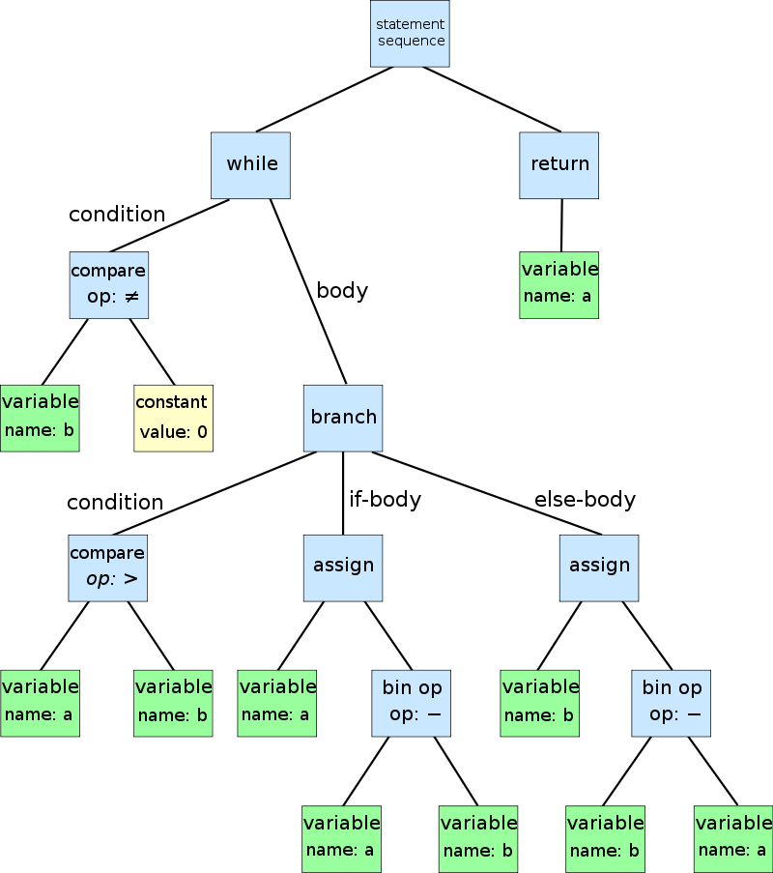
What does an AST look like
Source: https://en.wikipedia.org/wiki/Abstract_syntax_tree#/media/File:Abstract_syntax_tree_for_Euclidean_algorithm.svg

Slide 12
Why I didn’t use AST’s
A key reason to use AST’s is to eliminate ambiguity from a language
For languages like Java and C, they are very useful and helpful in making the languages unambiguous.
For InSpace, however, they are not very helpful and are almost overkill
InSpace is really a bunch of functions that can only be written in one way making the language itself strictly unambiguous
Because InSpace is already unambiguous, I did not implement AST’s because there was no reason to include them and instead just used the token stream to check syntax and semantics along with the symbol table.

Slide 13
Syntactic Analysis - My approach
10 different types of rule sets
1 rule set for each function
This works because InSpace has so few combinations that functions can be written, again part of way InSpace is so unambiguous
Compared the token stream to rule set stream
Used “quality of life” checks
Knew first token of every stream was the function name, used that to find rule set
If the length of the rule set and token stream did not match, already knew there was an error

Slide 14
Semantic Analysis Overview
After the rules are checked and the grammar structure is found to be correct, comes checking semantics
The goal with the semantic check is make sure that the use of the grammar makes sense in its context
For the language’s case, making sure variables, numbers, and strings are used in the correct context
Making sure variables and functions are declared before use
Making sure functions and loops have start’s and ends
Overall, everything to make sure the program makes sense

Slide 15
Semantic Analysis - How I approached it
The hardest part was to make sure I checked everything I needed to check
Multiple times as I got to the end, I realized that I was missing another check
Errors were handled in there own class
During Semantic Analysis, I updated the Symbol Table
Used a Type Checker class
If a variable was a function or just a variable
If an ID was a variable or number
Setting values for variables
I also handled looking for duplications and re-declarations that aren’t allowed

Slide 16
Error Handling
Wanted to have some sort of error handling to help user
Landed on two “error” classes that contained all the different error messages
Tried to help the user by providing the line the error occurred on in most cases, as well as what error was triggered.
Example of this later in the presentation

Slide 17
Inter Code Generation Overview
One of the final steps before making the target assembly
The goal with intercode is to simplify the code and turn it into a readable format
Very helpful when AST’s are in use
Also very helpful for performing optimizations to the source code

Slide 18
Inter Code Gen - My approach
The one stage that I found to be a little overkill with the language, and how I built my compiler
Decided to implement it in case I want to do optimization in the future and for the practice of generating intercode
Took the token streams that had been parsed and verified to be good to be translated and converted each token stream into intercode
Next up, the final step: code gen.

Slide 19
Quick Word on Optimization
Optimization is a step that typically comes after inter code generation
The goal of optimization is to decrease runtime and workload by “simplifying” the source code where it can.
Dynamic Programming
Removing Redundant code
Removing unreachable code
Many different algorithms to accomplish this, but it is complicated
I chose not to perform optimization on my code, but did want to touch on it as it is part of the compiler process, though not necessary.

Slide 20
Code Gen Overview
Assembly language is x86-64
Probably the most challenging part of the project
Assembly code is built to run on Linux
Why? I found it the easiest to work with. More on this later…
Takes the intercode and translates it into the desired assembly language
The final stage of a compiler and is what is considered to be part of the backend of a compiler

Slide 21
Assembly aka why it isn’t fun
Assembly = the evil son of machine code
Assembly also has an evil child
Segmentation Fault
Each OS likes to treat Assembly differently
Windows, Mac, and Linux all accept x86-64 in very different styles
Of all the different OS’s Linux provides the most straightforward and easiest implementation of x86-64
Mac OS is the 2nd easiest, but with a few major changes
Windows is by far the most complicated and hardest to implement
Only wanted to throw my computer across the room 3 times during this step...

Slide 22
Code Gen - My Approach
Utilized printf function to handle printing output to screen
Also utilized, .bss section for declaring variables
InSpace being functions allowed me to create blocks of assembly for each function
Hardest part were loops and functions
Learned the difference between caller and callee registers after two hours of infinite loops and segmentation faults…
Still, after all of this, I feel like I learned a lot about assembly and how assembly works and memory management and the different blocks of memory you can make.

Slide 23
Assembler and Linking and Loading
The assembler I used was NASM (Netwide Assembler)
Documentation for it can be found here : http://www.nasm.us/
Linking and loading was handled with clang
Used with clang in order to have access to the printf method
Gcc also works in the this case (though there is a debate clang is better….)
Documentation can be found here:
Clang: https://clang.llvm.org/get_started.html
These two pieces of software are then called via the terminal with the source file to produce the output

Slide 24
Biggest Question: Does the compiler work?
Yes!
Example time!

Slide 25
Reflection - What went well
Got the compiler to actually work!!!
Even though it took a bit, assembly went better than expected
Syntactical and Semantic Analysis (parsing) was made easier due to a lack of AST
Very cool to see everything come together and see an otherwise meaningless language be turned into a working programming language.
Get to contribute to the esolang community by making an implementation for an unimplemented language.

Slide 26
Reflection - What I could improve on
Character limits for input
One of the more complex parts of assembly
Found myself constantly going back and making edits to the lexical analyzer
Should have done more through testing on this before moving on to the other stages
Compiler is limited to running on Linux only
Not a huge deal with VM’s but still something that bothers me

Slide 27
Reflection: The future of the compiler
Probably going to take a break for a bit
I do want to return to it though!
Want to add functionality to at least Mac OS
Think this is reasonable
May touch windows in the future, but x86-64 on windows is very complicated to implement
Want to add other functionality to InSpace language
Multiplication and Division
More functions
For loops
Allow for larger size inputs to the program
Bigger numbers and sentences

Slide 28
Opinion of Compiler Design
Probably won’t make a career out of this
I do want to explore them more though
Want to look into optimization algorithms and their implementation
There was a time I wanted to make a ANSI compliant C compiler…
Needless to say I will not be doing this

Slide 29
Should you have felt bad for me cont.
Now back to the real question
Was this fun to do?
Answer: Not really… fun to see things come together, not fun to code out lots of different checks that are similar
Was this rewarding to do?
Answer: Absolutely! Seeing output for the first time come up on the screen, may be one of the most rewarding moments of my comp sci career.
Which leads back to the original answer of maybe
Like one of my friends told me once: “It was the best thing ever that I never want to do again”

Slide 30
To conclude… One Final Quote
In the words of my friend…
“It was the best thing ever, that I never want to do again”

Slide 31
Questions?
Github: https://github.com/tobes898
Email: tsduncan@smcm.edu

Slide 32
Work Cited
Aho, Alfred Vaino, et al. Compilers: Principles, Techniques and Tools. Pearson Education Ltd., 2014.
Hilfinger, Paul N. “CS164: Programming Languages and Compilers.” CS164: Programming Languages and Compilers, Spring 2009, UC Berkeley, 19 Jan. 2009, inst.eecs.berkeley.edu/~cs164/sp09/.
“NASM and IA-32 Information.” Sample 64-Bit Nasm Programs, UMBC, 27 Jan. 2015, www.csee.umbc.edu/portal/help/nasm/sample_64.shtml.
Zayne. “InSpace.” InSpace - Esolang, 16 Aug. 2017, esolangs.org/wiki/InSpace.

